Slide 1

FUNCTIONAL PRORAMMING
SCALA
TASKS
TEAM MEMBERS:
SHAHZAIB
FIZZA

Slide 2
Part 1 - functions in the real world
1. DEFINE THE PROBLEM:
Call users DAO and find the given user then convert user into HTML, display his information on a success page in case of missing user database call user DAO but there is no user without giving id, then display error page.
2. OUTLINE THE SOLUTION :
A function of user DAO will be created having the list of users and the current user as a parameter then it will check if the current user exist in the list of users, if TRUE it will show a success page with user information else, it will show error page.

Slide 3
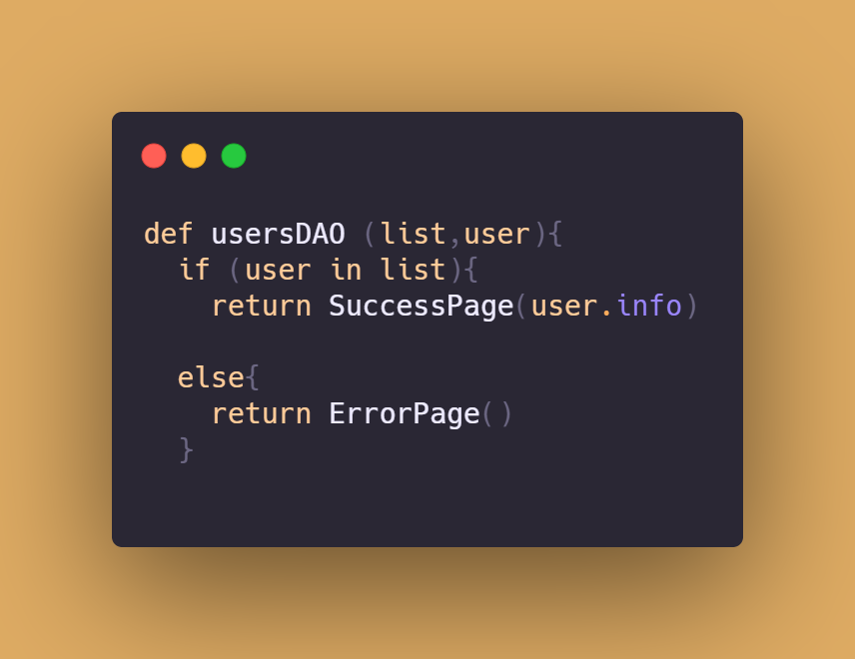
3. ALGORITHM: 4. TEST ALGORITHM:
sdsf
If user found in list
It returns user information.
If user not in list
It indicate error.

Slide 4
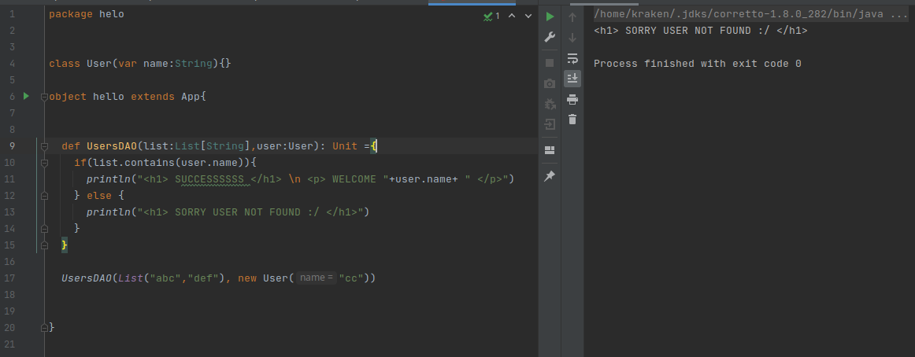
5. PROGRAM: 6. TEST PROGRAM:

Slide 5
7.Documentation:
First User Class is defined, having name as attribute
Function UsersDAO has 2 parameters
- list having List of String
- user having User object
if list has user.name parameter in it, by using list.contains(user)
then Success Page with user.name will be displayed, with user.name
Otherwise Error page will be displayed, saying that user not found.

Slide 6
OVERWIEW:

Slide 7
Part 2 - Understand Optionality Effect
1. DEFINE THE PROBLEM:
Handle two scenarios with high order functions:
Having Option as a type allow us to execute pure functions which are referentially transparent in context of missing value, Because Option type has available set of very useful high order functions so it is very easy to use pure functions to handle happy path and also to build second path in case of empty value
we can just pass to option set of recipes in case of success and failure.
2. OUTLINE THE SOLUTION :
A function of user DAO will be created having the list of users and the id of user as a parameter then we will check if list contains the user of id, based on that success and error pages will be shown by using fold.

Slide 8
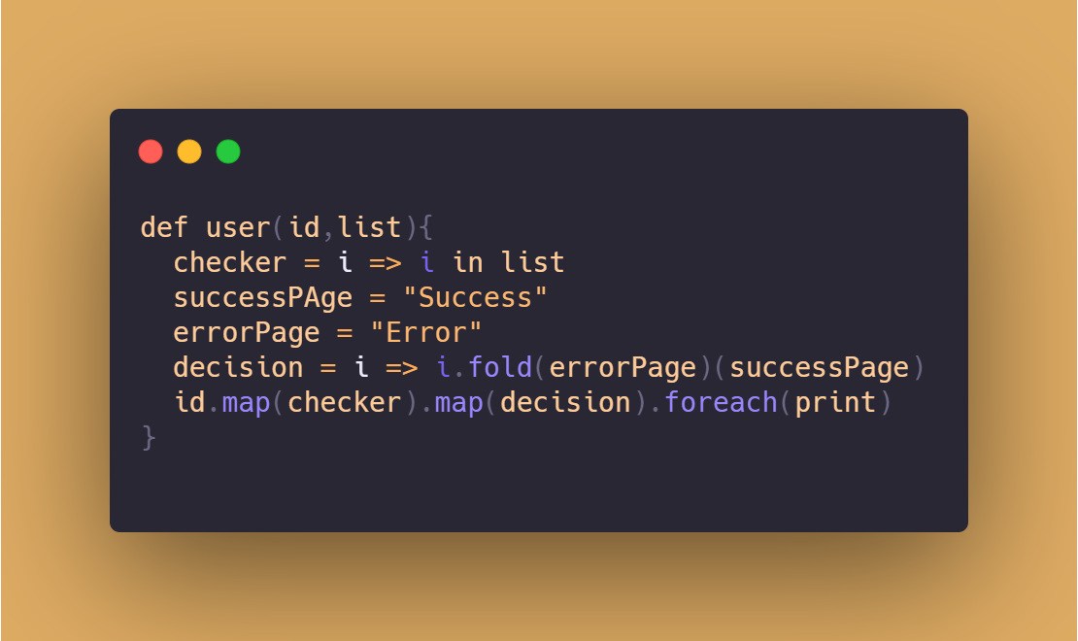
3. ALGORITHM: 4. TEST ALGORITHM:
Checker will check the existence of id in list
Decision will decide error or success page.
Then id will be mapped with checker then with decision then result will be printed

Slide 9
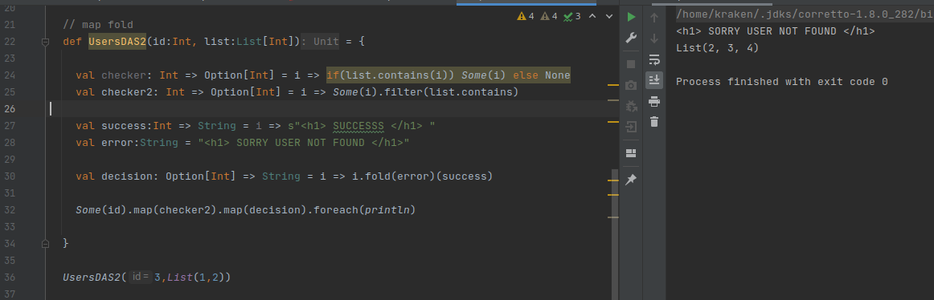
5. PROGRAM: 6. TEST PROGRAM:

Slide 10
7.Documentation:
First UsersDAO function is created with 2 parameters
Id of Int
List of List of Int
Checker is defined as arrow head function, returning the if i exists in list or not, by using filter with list.contains method.
Success and error are string showing success and error messages respectively.
Decision is defined as arrow head function returning success or error page by using fold and giving it success and error.
Finally id with some is mapped with checker, to check in list, then with decision to decide success or error page, then foreach’ed with println to print the output directly.

Slide 11
Part 3 - Multiple Optional Effects
1. DEFINE THE PROBLEM:
To display user last meetup and list of meetup.
2. OUTLINE THE SOLUTION :
A variable lastMeetup is defined as arrow-head function returning last meetup, and listOfMeetups returning list of Meetups, then a function for userLastMeetup is defined taking user and lastMeetup method as parameter, in which user is executed with the lastMeetup function. Similarly meetupHistory will be implemented which will return list of meetups.

Slide 12
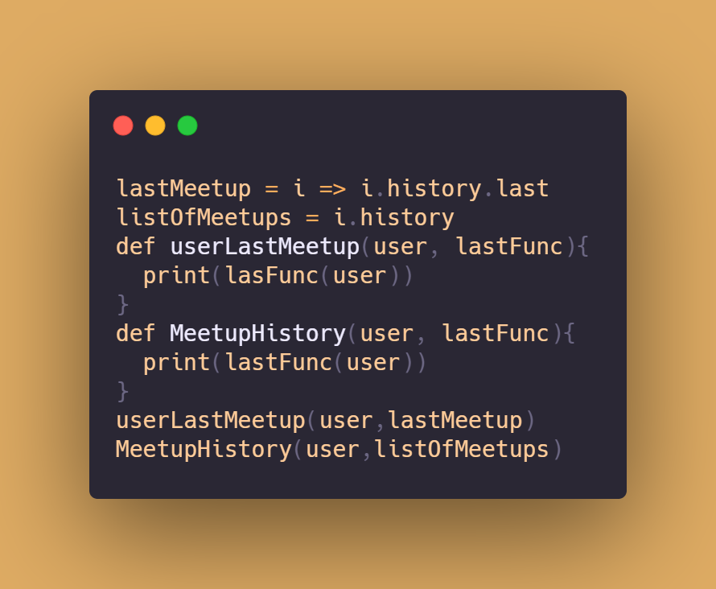
3. ALGORITHM: 4. TEST ALGORITHM:
Functions are pure taking both the function and user as parameter to execute and derive the result.

Slide 13
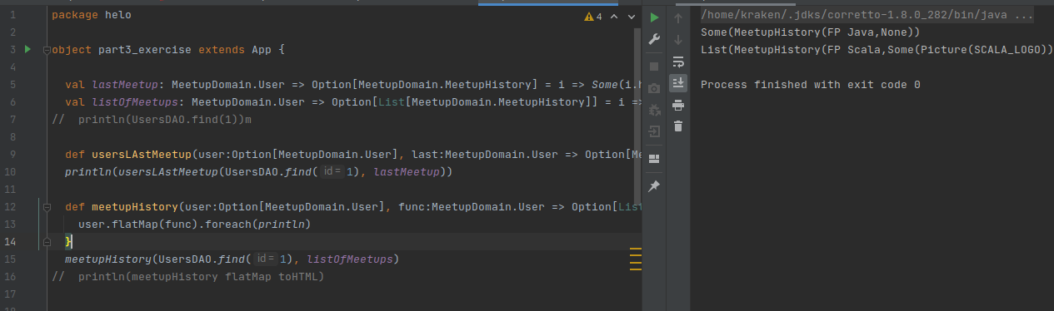
5. PROGRAM: 6. TEST PROGRAM:

Slide 14
7.Documentation:
UserDAO class will be the same
lastMeetup arrow-head is defined returning optional lastMeetup of user, by user.meetup.last; last gives the last index of list.
meetupHistory attow-head is defined returning optional list of meetups of user, by user.meetup
Then these arrow-heads are send to Functions along with users to return the results for last meetup and list of meetups respectively.

Slide 15
Part 4 - For Comprehension
1. DEFINE THE PROBLEM:
When we have a lot of effect types using map and flat Map can make our code less readable.
Fortunately Scala introduces a very powerful language construct - for-comprehension
So in this exercise join optional values
2. OUTLINE THE SOLUTION :
A function of join taking 3 option string and concatenate it using for comprehension.

Slide 16
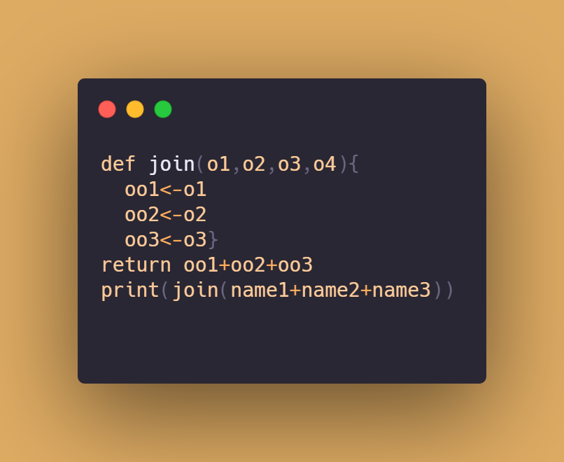
3. ALGORITHM: 4. TEST ALGORITHM:
join couple optional values with for comprehension, and instead of using map and flatMap, for-comprehension returns the same answer a lot cleaner.

Slide 17
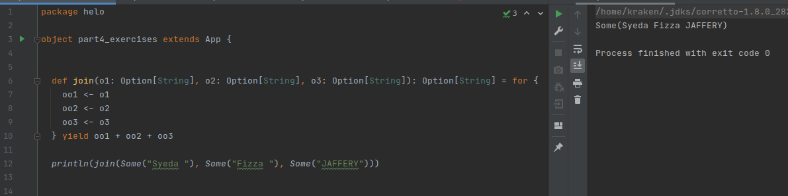
5. PROGRAM: 6. TEST PROGRAM:

Slide 18
7.Documentation:
UserDAO class will be the same
Function join taking the three option strings, for comprehension.
And return (yield) them after adding so that whether it is string, concatenation is performed.

Slide 19
Part 5 - Error Effect
1. DEFINE THE PROBLEM:
While Option tell us that something Is present/Is missing Try is prepared to handle multiple error path for different exceptions. Try has two subtypes Success and Failure. We can recover to happy path if you know how to handle specific exception. or we can apply independent handler procedures, in tis exercise we have to add error affects.
2. OUTLINE THE SOLUTION :
A function toStr taking string have try and catch features. addStr is adding all strings and then a new function trytoAdd try to add strings via option try string, and return (yield) their sum.

Slide 20
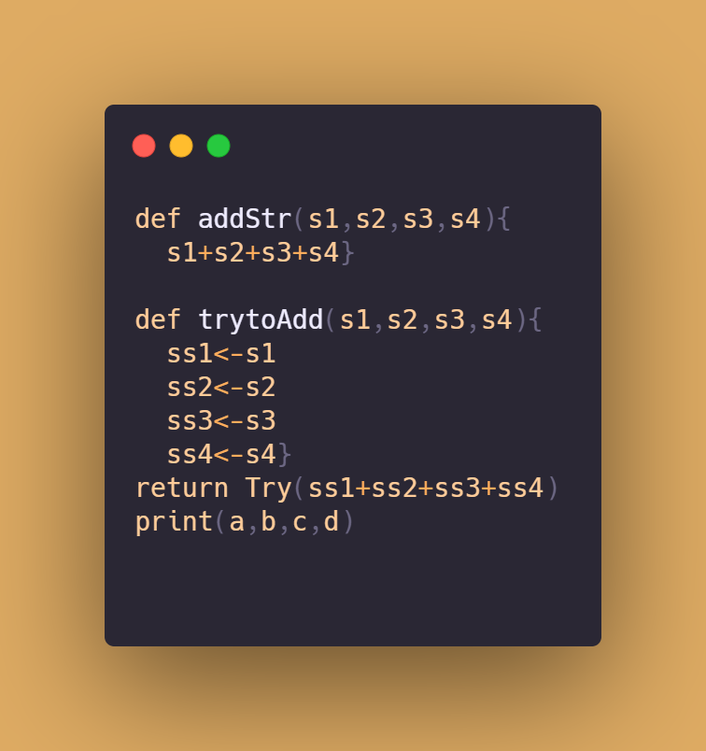
3. ALGORITHM: 4. TEST ALGORITHM:
A function addStr is adding all strings
Function trytoAdd try to add strings via Option try string, and return (yield) their sum.
Then println prints the result (a,b,c,d)

Slide 21
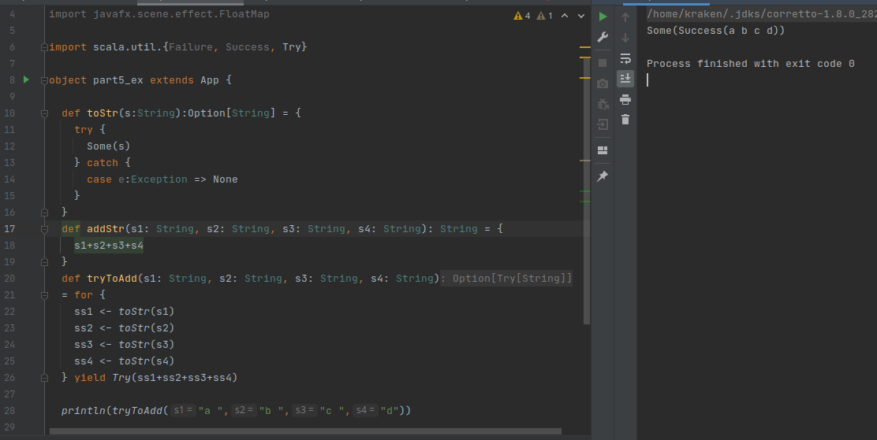
5. PROGRAM: 6. TEST PROGRAM:

Slide 22
7.Documentation:
UserDAO class will be the same
Function toStr take option string and run-on case of try and catch.
A function addStr is adding all strings
Function trytoAdd try to add strings via Option try string, and return (yield) their sum.

Slide 23
Part 7 - Other Effects
1. DEFINE THE PROBLEM:
We have multi values lists and we have to make all possible combinations.
2. OUTLINE THE SOLUTION :
We make 2 case classes Driver and Car and also take 2 lists drivers, cars for each.
After that, a function combination is being created on which the combinations formed by for comprehension.

Slide 24
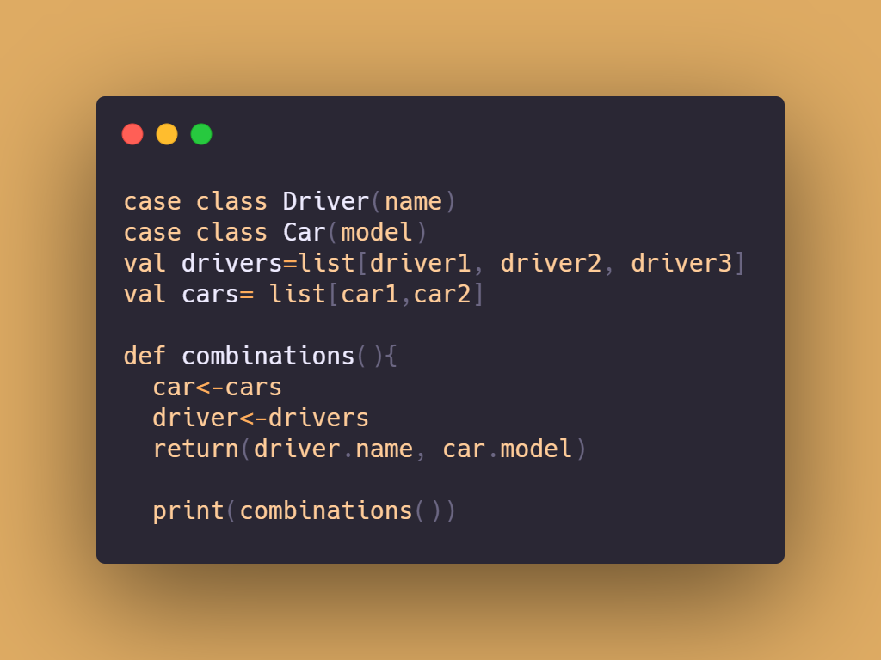
3. ALGORITHM: 4. TEST ALGORITHM:
Case class Driver take name as a parameter
Case class Car take model as a parameter
Function combination (using for comprehension) make all possible pairs of both lists.

Slide 25
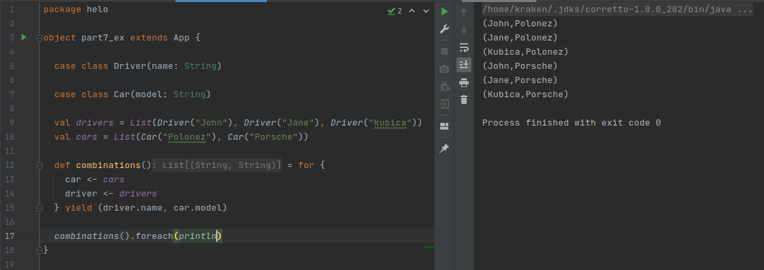
5. PROGRAM: 6. TEST PROGRAM:

Slide 26
7.Documentation:
UserDAO class will be the same
Case class Driver take name as a parameter
Case class Car take model as a parameter
There are lists for each named cars and drivers.
Function combination (using for comprehension) make all possible pairs of both lists.
And print it in different lines using foreach function.

Slide 27


